Slide 1
Machine Learning in Business, 3rd Edition
Chapter 3: Supervised Learning: Linear and Logistic Regression

Slide 2
Linear Regression
Linear regression is a very popular tool because once you have made the assumption that the model is linear you do not need huge amount of data
In ML we refer to the constant term as the bias and the coefficients as weights

Slide 3
Linear Regression continued
Assume n observations and m features. Model is
Y = a+b₁X₁+b₂X₂+….+b_{m}X_{m}+ε
Standard approach is to choose a and the b_{i} to minimize the mean square error (mse).
This can be done analytically by inverting a matrix. Alternatively a numerical (gradient descent) method can be used

Slide 4
Gradient Descent (brief description: more details when neural networks are discussed)
The objective is to minimize a function by changing parameters. Steps are as follows:
  Choose starting value for parameters
  Find the steepest slope: i.e. the direction in which parameter have to be changed to reduce the objective function by the greatest amount
  Take a step down the valley in the direction of the steepest slope
  Repeat steps 2 and 3
  Continue until you reach the bottom of the valley

Slide 5
Categorical Features
Categorical features are features where there are a number of non-numerical alternatives
We can define a dummy variable for each alternative. The variable equals 1 if the alternative is true and zero otherwise. This is known as one-hot encoding
But sometimes we do not have to do this because there is a natural ordering of variables, e.g.:
    small=1, medium=2, large=3
    assist. prof=1, assoc. prof=2, full prof =3

Slide 6
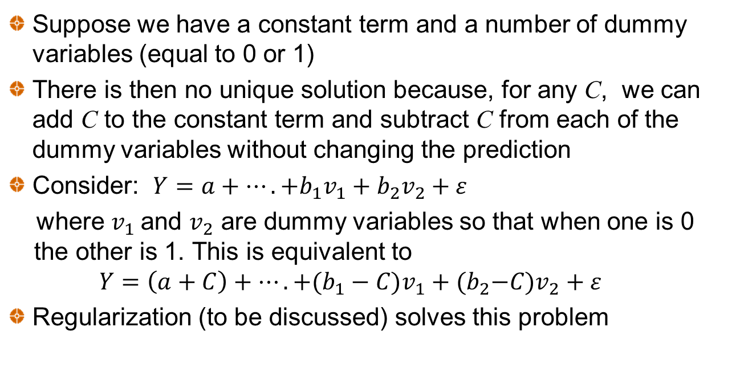
Dummy Variable Trap
Suppose we have a constant term and a number of dummy variables (equal to 0 or 1)
There is then no unique solution because, for any C, we can add C to the constant term and subtract C from each of the dummy variables without changing the prediction
Consider: $Y=a+….+b_{1}v_{1}+b_{2}v_{2}+ε$
where $v_{1}$and $v_{2}$ are dummy variables so that when one is 0 the other is 1. This is equivalent to
$$Y=\left(a+C\right)+….+(b_{1}−C{)v}_{1}+{(b}_{2}−C)v_{2}+ε$$
Regularization (to be discussed) solves this problem

Slide 7
The Correlation Problem
Suppose two features to estimate house price are
  X₁: Square feet of basement
  X₂: Square feet of first floor
  Best fit to training set might be:
  Price($’000s) = 10X₁−9.5X₂
  This almost certainly overfits. A better model is something similar to:
  Price($’000s) = 0.5X₁ or Price($’000s) = 0.5X₂

Slide 8
Regularization
Regularization is a way of avoiding overfitting and possibly simplifying the model by reducing the number of features.
Alternatives:
  Ridge
  Lasso
  Elastic net
We must first scale feature values

Slide 9
Ridge regression (analytic solution)
Reduce magnitude of regression coefficients by choosing a parameter λ and minimizing
What happens as λ increases?

Slide 10
Lasso Regression (must use gradient descent)
Similar to ridge regression except we minimize
This has the effect of completely eliminating the less important features

Slide 11
Elastic Net Regression (must use gradient descent)
Middle ground between Ridge and Lasso
Minimize

Slide 12
Baby Example (from Chapter 1)
Age (years) | Salary ($)
25 | 135,000
55 | 260,000
27 | 105,000
35 | 220,000
60 | 240,000
65 | 265,000
45 | 270,000
40 | 300,000
50 | 265,000
30 | 105,000

Slide 13

Baby Example continued
We apply regularization to the model:
$Y=a+b_{1}X+b_{2}X^{2}$ $+b_{3}X^{3}$ $+b_{4}X^{4}$ $+b_{5}X^{5}$
where Y is salary and X is age

Slide 14
Data with Z-score scaling (Table 3.3)
Observ. | X | X² | X³ | X⁴ | X⁵
1 | −1.290 | −1.128 | −0.988 | −0.874 | −0.782
2 | 0.836 | 0.778 | 0.693 | 0.592 | 0.486
3 | −1.148 | −1.046 | −0.943 | −0.850 | −0.770
4 | −0.581 | −0.652 | −0.684 | −0.688 | −0.672
5 | 1.191 | 1.235 | 1.247 | 1.230 | 1.191
6 | 1.545 | 1.731 | 1.901 | 2.048 | 2.174
7 | 0.128 | −0.016 | −0.146 | −0.253 | −0.333
8 | −0.227 | −0.354 | −0.449 | −0.511 | −0.544
9 | 0.482 | 0.361 | 0.232 | 0.107 | −0.004
10 | −0.936 | −0.910 | −0.861 | −0.803 | −0.745

Slide 15
Ridge Results, Table 3.4 (λ=0.02 is similar to quadratic model)
λ | a | b₁ | b₂ | b₃ | b₄ | b₅
0 | 216.5 | −32,623 | 135,403 | −215,493 | 155,315 | −42,559
0.02 | 216.5 | 97.8 | 36.6 | −8.5 | 35.0 | −44.6
0.10 | 216.5 | 56.5 | 28.1 | 3.7 | −15.1 | −28.4

Slide 16
Lasso Results, Table 3.5 (λ=1 is similar to the quadratic model)
λ | a | b₁ | b₂ | b₃ | B₄ | b₅
0 | 216.5 | −32,623 | 135,403 | −215,493 | 155,315 | −42,559
0.02 | 216.5 | −646.4 | 2,046.6 | 0.0 | −3,351.0 | 2,007.9
0.1 | 216.5 | 355.4 | 0.0 | −494.8 | 0.0 | 196.5
1 | 216.5 | 147.4 | 0.0 | 0.0 | −99.3 | 0.0

Slide 17
Elastic Net Results: λ₁ = 0.02, λ₂=1
$$Y=216.5+96.7X+21.1X^{2}−26.0X^{4}−45.5X^{5}$$

Slide 18
Iowa House Price Case Study
The objective is to predict the prices of houses in Iowa from features
800 observations in training set, 600 in validation set, and 508 in test set

Slide 19
Iowa House Price Results (No regularization)
2 categorical variables included. Natural ordering for Basement quality. 25 dummy variables created for neighborhood
Lot area (squ ft) 0.08 | Number of half bathrooms 0.02
Overall quality (scale from 1 to 10) 0.21 | Number of bedrooms −0.08
Overall condition (scale from 1 to 10) 0.10 | Total rooms above grade 0.08
Year built 0.16 | Number of fireplaces 0.03
Year remodeled 0.03 | Parking spaces in garage 0.04
Basement finished squ ft 0.09 | Garage area (squ ft) 0.05
Basement unfinished squ ft −0.03 | Wood deck (squ ft) 0.02
Total basement squ ft 0.14 | Open porch (squ ft) 0.03
1st floor squ ft 0.15 | Enclosed porch (squ ft0 0.01
2nd floor squ ft 0.13 | Neighborhood (25 alternatives) −0.05 to 0.12
Living area 0.16 | Basement quality (6 natural ordering) 0.01
Number of full bathrooms −0.02

Slide 20
Ridge Results for validation set (Figure 3.8)

Slide 21
Lasso Results for validation set (Figure 3.9)

Slide 22
Non-zero weights for Lasso when λ=0.1 (overall quality and total living area were most important)
Feature | Weight
Lot Area (square feet) | 0.04
Overall quality (Scale from 1 to 10) | 0.30
Year built | 0.05
Year remodeled | 0.06
Finished basement (square feet) | 0.12
Total basement (square feet) | 0.10
First floor (square feet) | 0.03
Living area (square feet) | 0.30
Number of fireplaces | 0.02
Parking spaces in garage | 0.03
Garage area (square feet) | 0.07
Neighborhoods (3 out of 25 non-zero) | 0.01, 0.02, and 0.08
Basement quality | 0.02

Slide 23
Summary of Iowa House Price Results
With no regularization correlation there is overfitting. Some weights are negative when we would expect them to be positive
Improvements from Ridge is modest
Lasso leads to a much bigger improvement in this case
Elastic net similar to Lasso in this case
Mean squared error for test set for Lasso with λ=0.1 is 14.7% so that 85.3% of variance is explained (compared with 88.6% when there is no regularization)
Notes:
14.4% so that

Slide 24
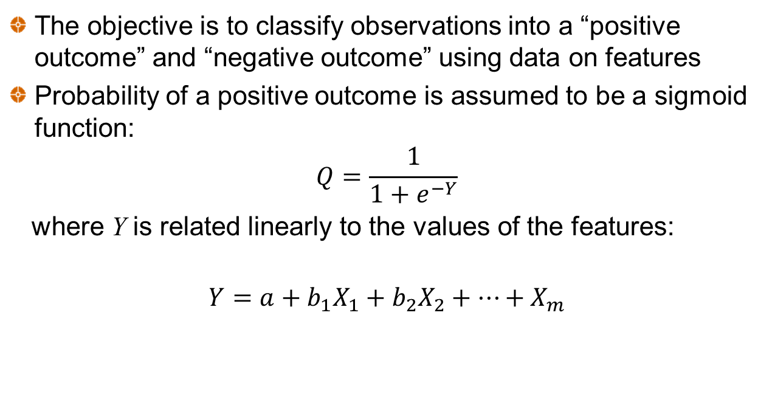
Logistic Regression
The objective is to classify observations into a “positive outcome” and “negative outcome” using data on features
Probability of a positive outcome is assumed to be a sigmoid function:
$$Q=\frac{1}{1+e^{−Y}}$$
where Y is related linearly to the values of the features:
$$Y=a+b_{1}X_{1}+b_{2}X_{2}+⋯+X_{m}$$

Slide 25
The Sigmoid Function (Figure 3.10)

Slide 26
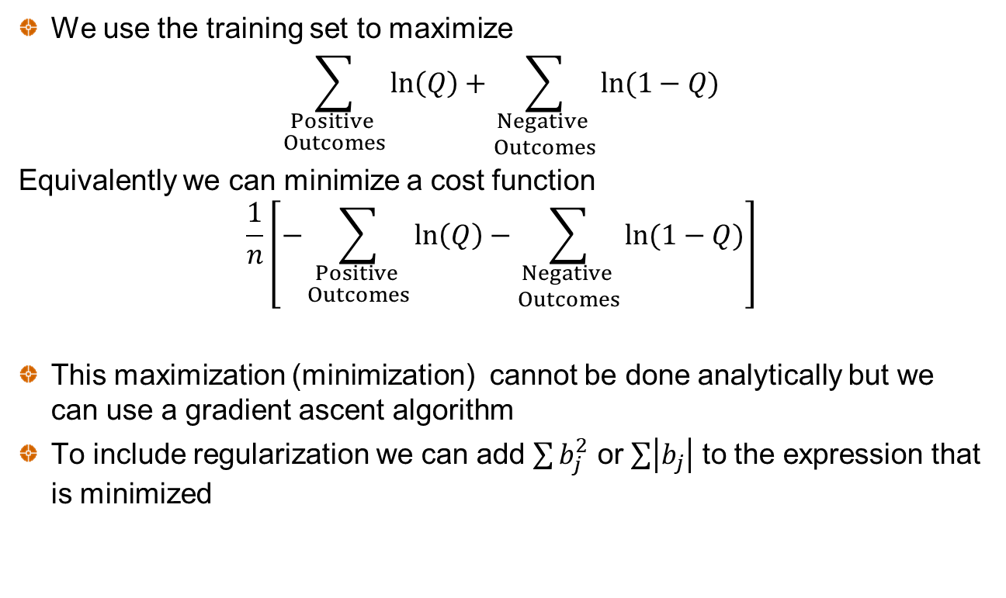
Maximum Likelihood Estimation
We use the training set to maximize
$$\sum_{\begin{aligned}Positive \\ Outcomes\end{aligned}}{\ln\left(Q\right)+\sum_{\begin{aligned}Negative \\ Outcomes\end{aligned}}{ln⁡(1−Q)}}$$
Equivalently we can minimize a cost function
$$\frac{1}{n}\left[−\sum_{\begin{aligned}Positive \\ Outcomes\end{aligned}}{\ln\left(Q\right)−\sum_{\begin{aligned}Negative \\ Outcomes\end{aligned}}{ln⁡(1−Q)}}\right]$$
This maximization (minimization) cannot be done analytically but we can use a gradient ascent algorithm
To include regularization we can add $\sum{b_{j}^{2}}$ or $\sum{\left|\left.b_{j}\right|\right.}$ to the expression that is minimized

Slide 27
Lending Club Case Study
Data consists of loans made and whether they proved to be good or defaulted.
We use only four features
  Home ownership (rent vs. own)
  Income
  Debt to income
  Credit score
Dat set has 12,290 observations (9,733 good loans “Fully Paid” and 2,557 defaulting loans “Charged Off”). 7,000 loans were put in training set, 3,000 in validation set, and 2,290 in test set

Slide 28
The Data (Table 3.8)
Home Ownership 1=owns, 0 =rents | Income ($’000) | Debt to Income (%) | Credit score | 1=Good, 0=Default
1 | 44.304 | 18.47 | 690 | 0
0 | 50.000 | 29.62 | 735 | 1
0 | 64.400 | 16.68 | 675 | 1
0 | 38.500 | 33.73 | 660 | 0
 | …. |  |  | ….
 | ….. |  |  | ….

Slide 29
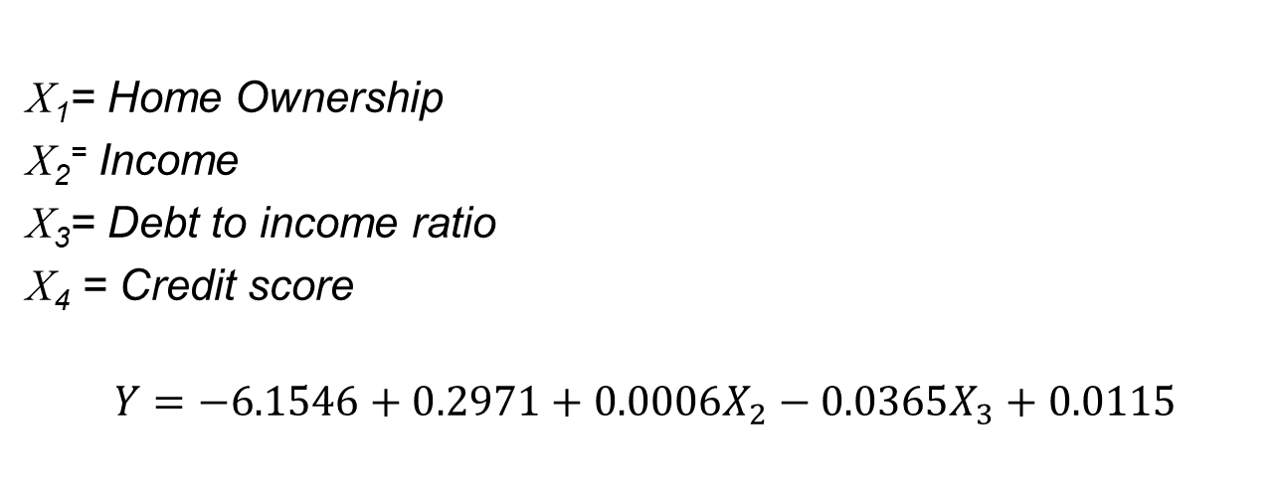
Results for Lending Club Training Set (Unscaled data)
X₁= Home Ownership
X₂⁼ Income
X₃= Debt to income ratio
X₄ = Credit score
$$Y=−6.1546+0.2971+0.0006X_{2}−0.0365X_{3}+0.0115$$

Slide 30
Decision Criterion
The data set is imbalanced with more good loans than defaulting loans
There are procedures for creating a balanced data set
With a balanced data set we could classify an observation as positive if Q > 0.5 and negative otherwise
However this does not consider the cost of misclassifying a bad loan and the lost profit from misclassifying a good loan
A better approach is to investigate different thresholds, Z
  If Q > Z we accept a loan
  If Q ≤ Z we reject the loan

Slide 31
Test Set Results (Tables 3.10, 3.11, and 3.12)
 | Predict no default | Predict default
Outcome positive (no default) | 60.83% | 18.34%
Outcome negative (default) | 11.70% | 9.13%
Z = 0.75:
 | Predict no default | Predict default
Outcome positive (no default) | 42.71% | 36.46%
Outcome negative (default) | 6.46% | 14.76%
Z=0.80:
 | Predict no default | Predict default
Outcome positive (no default) | 22.75% | 56.42%
Outcome negative (default) | 3.01% | 17.82%
Z=0.85:

Slide 32

The Confusion matrix and common ratios
 | Predict positive outcome | Predict negative outcome
Outcome positive | TP | FN
Outcome negative | FP | TN
$$Accuracy= \frac{TP+TN}{TP+FN+FP+TN}$$
$$True Positive Rate (TPR also called sensitivity or recall)= \frac{TP}{TP+FN}$$
$$The True Negative rate\left(also called specificity\right)= \frac{TN}{TN+FP}$$
$$The False Positive Rate= \frac{FP}{TN+FP}$$
$$Precision, P= \frac{TP}{TP+FP}$$
$$F score=2× \frac{P×TPR}{P+TPR}$$

Slide 33
Test Set Ratios for different Z values (Table 3.14)
 | Z=0.00 | Z = 0.75 | Z = 0.80 | Z = 0.85 | Z=1.00
Accuracy | 79.17% | 69.96% | 57.07% | 40.57% | 20.83%
True Positive Rate | 100.00% | 76.83% | 53.94% | 28.74% | 0.00%
True Negative Rate | 0.00% | 43.82% | 68.97% | 85.53% | 100.00%
False Positive Rate | 100.00% | 56.18% | 31.03% | 14.47% | 0.00%
Precision | 79.17% | 83.87% | 86.86% | 88.31% | n.a.
F-score | 88.37% | 80.20% | 66.55% | 43.36% | n.a.

Slide 34
As we change the Z criterion we get an ROC curve (receiver operating characteristics) curve, Figure 3.11

Slide 35
Area Under Curve (AUC)
The area under the curve is a popular way of summarizing the predictive ability of a model to estimate a binary variable
When AUC =1 the model is perfect.
When AUC =0.5 the model has no predictive ability
When AUC < 0.5 the model has negative predictive ability
In this case AUC = 0.6578

Slide 36
Choosing Z
The value of Z can be based on
  The expected profit from a loan that is good, P
  The expected loss from a loan that defaults, L
We need to maximize P×TP−L×FP

Slide 37
A Simple Alternative to regression : k-nearest neighbors
Normalize data
Measure the distance in n-dimensional space of the new data from the data for which there are labels (i.e. known outcomes)
Distance of point with feature values x_{i} from point with feature values y_{i} is
Choose the k closest data items and average their labels
For example, if you are forecasting car sales in a certain area with k=3 and the three nearest neighbors for GDP growth and interest rates give sales of 5.2, 5.4 and 5.6 million units, the forecast would be the average of these or 5.4 million units.
If you are forecasting whether a loan will default with k=5 and that of the five nearest neighbors four defaulted and one was good loan, you would estimate an 80% chance of default

